Slide 1
CC-05 methods
54C cells were grown for 4 days in T175 (p22). Cells were ~85% confluent before trypsinisation in T175 flasks
54C cells (2.5x 10⁵ cells/5 mL) were plated in p60 dishes incubated for 20 h under oxia.
On the next day (20 h after plating) cells were ~25% confluent in p60 dishes (before drug treatment).
Cells were irradiated at 0 and 6Gy
Cell cycle assay (n=3 per treatment)
100 uM EdU solution was made in media and incubated in water bath (in 50 mL falcon tubes) before RT
0 h sample: Immediately after RT, media was removed and added 5 mL of 100 uM EdU in media. Plates were incubated at 37 °C for 0.5 h or 1 h before fixing cells (70% EtOH)
0.5, 1, 2, 3, 4, 24 h after RT, media was replaced with 100 uM EdU and incubated for 0.5 h at 37 °C before fixing cells
Cells were treated with PI just before FCM analysis
Cells were ~50% confluent at 24 h in p60 dishes after RT
Treatment time (hh:mm)
Samples: Time after RT | Radiation | EdU | fixing
0 h | 12:35 | 12:50 | 13:20
0.5 h | 15:15 | 15:59 | 16:29
1 h | 12:55 | 14:06 | 14:39
2 h | 13:43 | 15:59 | 16:29
3 h | 12:55 | 16:08 | 16:38
4 h | 12:35 | 16:50 | 17:29
24 h | 13:43 | 14:00 (next day) | 14:30 (next day)

Slide 2
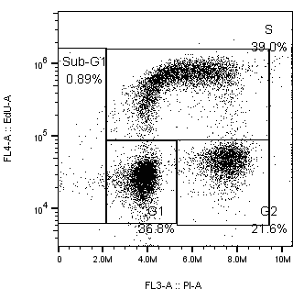
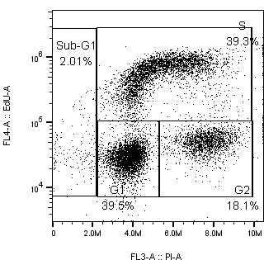
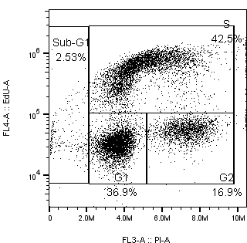
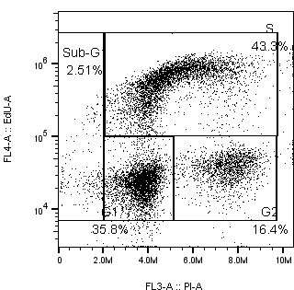
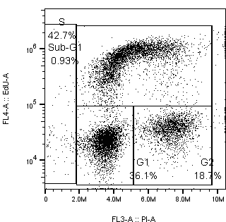
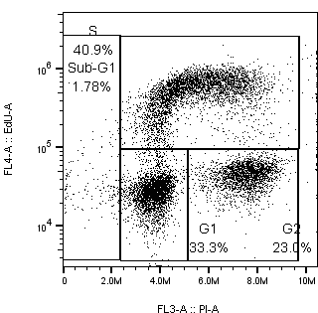
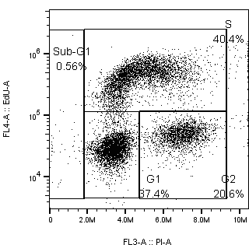
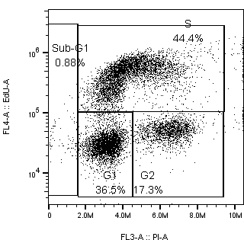
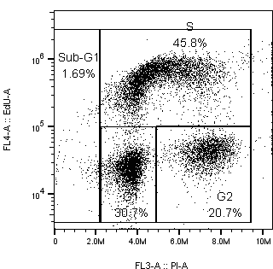
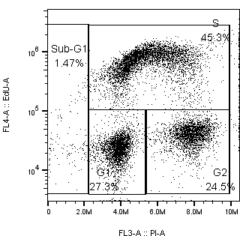
30 min EdU treatment (showing 1 sample/treatment but I did n=3)
 | 0 h | 0.5 h | 1 h | 2 h | 3 h
Control
6 Gy

Slide 3
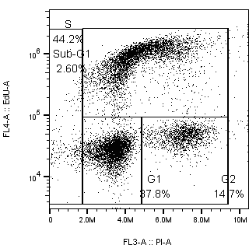
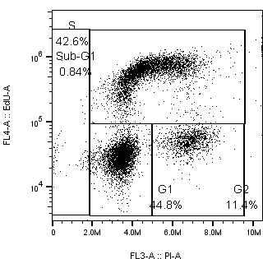

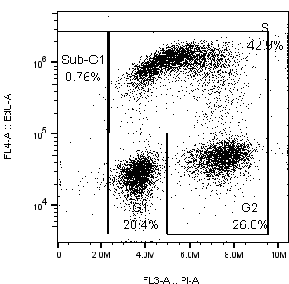
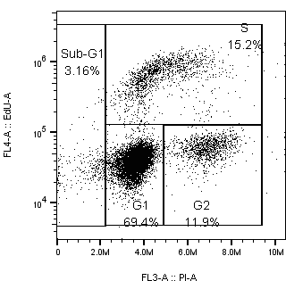
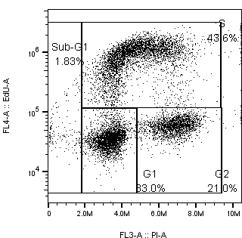
30 min EdU treatment (showing 1 sample/treatment but I did n=3)
 | 0 h | 4 h | 24 h | 0 h – 60 min EdU
Control
6 Gy

Slide 4
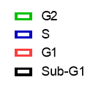
EdU treatment for 30 min vs 60 min
EdU was added at 0 h (immediately after RT)
EdU treatment for 30 min vs 60 min at 37 °C
Cell cycle %
Med EdU value
(EdU treatment)
%
%
 | Sub-G1 | G1 | S | G2
30 min | 1.7 | 38.1 | 37.7 | 21.1
60 min | 1.5 | 36.9 | 41.0 | 19.6
 | Sub-G1 | G1 | S | G2
30 min | 1.5 | 34.0 | 40.9 | 22.7
60 min | 1.8 | 33.2 | 43.1 | 21.4
Slight increase in S-phase cells (%) after 60 min treatment than 30 min treatment
0 Gy
6 Gy
Median EdU in S-phase cells after 60 min EdU treatment is ~2-fold higher than 30 min treatment
 | G1 | S | G2
30 min | 24322 | 523000 | 41145
60 min | 31187 | 1140000 | 54410
 | G1 | S | G2
30 min | 26764 | 496333 | 44114
60 min | 34426 | 939000 | 59409

Slide 5
Cell cycle % (EdU treatment: 30 min)
Cells were ~50% confluent in p60 dishes 24 h after RT.
24 h: higher G1 % but lower S and G2 %
(consistent with prev expt)
Time h | Sub-G1 | G1 | S | G2/M
0 | 1.7 | 38.1 | 37.7 | 21.1
0.5 | 1.7 | 39.8 | 39.0 | 18.4
1 | 1.2 | 37.6 | 43.4 | 16.8
2 | 1.8 | 37.6 | 43.1 | 16.1
3 | 1.2 | 36.1 | 43.2 | 18.0
4 | 1.9 | 38.0 | 44.7 | 14.6
24 | 1.1 | 44.8 | 42.4 | 11.5
Time h | Sub-G1 | G1 | S | G2/M
0 | 1.5 | 34.0 | 40.9 | 22.7
0.5 | 0.9 | 36.6 | 40.7 | 21.0
1 | 1.4 | 36.3 | 43.9 | 17.3
2 | 2.4 | 30.5 | 45.4 | 20.7
3 | 1.4 | 27.8 | 45.0 | 24.5
4 | 1.2 | 27.9 | 43.0 | 27.0
24 | 2.5 | 70.5 | 15.4 | 11.7
Need to repeat this expt with later time points (8, 18 h)

Slide 6
Median EdU values
0 Gy
6 Gy
Time | G1 | S | G2
0 | 24322 | 523000 | 41145
0.5 | 29890 | 616000 | 50615
1 | 31874 | 590000 | 54201
2 | 26077 | 631333 | 44340
3 | 24147 | 763667 | 41452
4 | 27071 | 929667 | 46173
24 | 34731 | 591000 | 57414
Time | G1 | S | G2
0 | 26764 | 496333 | 44114
0.5 | 27634 | 425333 | 46717
1 | 28239 | 421295 | 47227
2 | 24813 | 547667 | 42024
3 | 22446 | 642500 | 38703
4 | 26598 | 953333 | 45759
24 | 40576 | 683000 | 64434
I’m not sure why med EdU value increases over time…
I didn’t see this trend in last expt (CC-04)..
Median Edu at 6 Gy normalised to median EdU at 0 Gy
**
Median EdU % (6 Gy/ 0Gy)
**
Time | G1 | S | G2
0 | 110.9 | 95.6 | 108.0
0.5 | 92.6 | 69.4 | 92.5
1 | 74.4 | 71.5 | 87.1
2 | 96.1 | 87.7 | 96.0
3 | 93.4 | 84.3 | 93.6
4 | 98.4 | 102.7 | 99.2
24 | 109.5 | 118.2 | 106.4
Max inhibition of EdU incorporation in S-phase cells was observed at 0.5 and 1 h after RT

Slide 7
Median EdU values
0 Gy
6 Gy
**
Time | S
0 | 601000* | 416000 | 630000
0.5 | 635000 | 654000 | 559000
1 | 603000 | 629000 | 538000
2 | 618000 | 732000 | 544000
3 | 714000 | 833000 | 744000
4 | 888000 | 983000 | 918000
24 | 610000 | 531000 | 632000
S
537000 | 490000 | 462000
452000 | 405000 | 419000
473000 | 409000 | 380886
545000 | 571000 | 527000
712000 | 573000 | **
967000 | 969000 | 924000
757000 | 672000 | 694000
Time | average
0 | 93.5
0.5 | 69.4
1 | 71.4
2 | 87.7
3 | 84.3
4 | 102.7
24 | 120.2
Time | 82.9
6 gy /0 gy *100
average
**
Not stained..not sure why
* New value added (higher G1 and G2 EdU value; that’s why it wasn’t included in the analysis)
 | G1 |  |  | S |  |  | G2
0 h | *72779 | 21643 | 27000 | *601000 | 416000 | 630000 | *100859 | 36945 | 45344
When median EdU values were analysed by 1-way ANOVA
there was a significant difference at 0.5 and 1 h between 0 and 6 Gy

Slide 8
New expt: CC- 05 (2.5 x 10⁵ cells/5 mL)
G2 fraction is ~2-fold higher at 0 h when cell seeding density is reduced by half (CC-05 vs CC-04)
Time | Sub-G1 | G1 | S | G2
0 | 1.7 | 38.1 | 37.7 | 21.1
0.5 | 1.7 | 39.8 | 39.0 | 18.4
1 | 1.2 | 37.6 | 43.4 | 16.8
2 | 1.8 | 37.6 | 43.1 | 16.1
3 | 1.2 | 36.1 | 43.2 | 18.0
4 | 1.9 | 38.0 | 44.7 | 14.6
24 | 1.1 | 44.8 | 42.4 | 11.5
Time | Sub-G1 | G1 | S | G2
0 | 1.5 | 34.0 | 40.9 | 22.7
0.5 | 0.9 | 36.6 | 40.7 | 21.0
1 | 1.4 | 36.3 | 43.9 | 17.3
2 | 2.4 | 30.5 | 45.4 | 20.7
3 | 1.4 | 27.8 | 45.0 | 24.5
4 | 1.2 | 27.9 | 43.0 | 27.0
24 | 2.5 | 70.5 | 15.4 | 11.7
Lower G1 % compared to CC-04 (below) but still higher than 0 h
24 h: increased G1 fraction, consistent with CC-04
Prev expt: CC- 04 (5 x 10⁵ cells/5 mL)
Time | Sub-G1 | G1 | S | G2
0 | 0.7 | 42.5 | 47.4 | 9.6
4 | 1.7 | 39.1 | 48.3 | 10.7
8 | 3.7 | 42.8 | 43.0 | 10.2
24 | 3.8 | 57.3 | 32.2 | 6.6
Rad (Gy) | Sub -G1 | G1 | S | G2
0 | 0.7 | 42.7 | 47.6 | 9.0
4 | 2.1 | 30.1 | 53.4 | 14.4
8 | 2.7 | 33.3 | 41.0 | 23.0
24 | 3.5 | 78.6 | 8.6 | 9.3

Slide 9
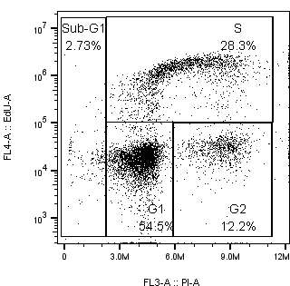
Another prev cell cycle expt (CA-121); standard 24-well plates format
At the time of RT
(5 h after trypsinisation)
18 h after radiation
18 h after RT: accumulation of G2 cells
Rad (Gy) | Sub-G1 | G1 | S | G2
0 | 1.7 | 44.8 | 39.6 | 13.2
2 | 4.2 | 50.3 | 29.1 | 15.8
4 | 4.9 | 51.4 | 18.3 | 23.8
6 | 4.0 | 50.4 | 13.5 | 31.6
8 | 4.3 | 33.3 | 12.8 | 48.7
%

Slide 10
Future plan
I will do cell cycle + clonogenic assay
2.5 x 10⁵ cells/p60/5mL on day 0 (treatment on the next day)
±SN39536? Add drug 30 min before RT?
EdU addition?
30 min treatment
Can’t replace media if SN39536 is added before RT
I added 100 uL EdU to 5 mL media in CC-04 (no need to replace media)
Clonogenic assay: 18 h after RT
Radiation: 0, 2, 4, 6, 8 Gy
Time points: 0, 8, 12, 18, 24 h (later time points needed to confirm G2 accumulation at 18 h post-RT (CA-121))
1.25 x 10⁵ cells/p60 for 0, 12, 18, 24 h

Slide 11
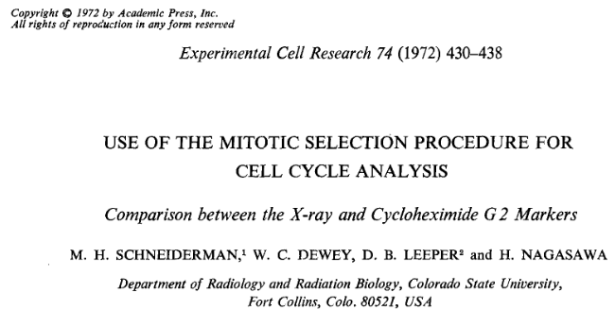
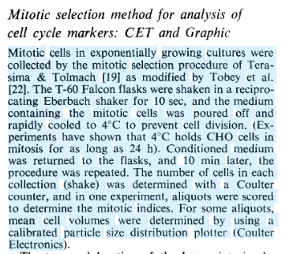
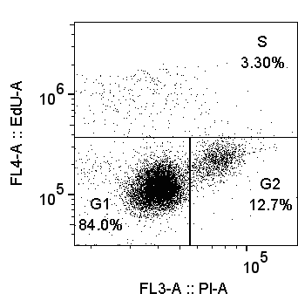
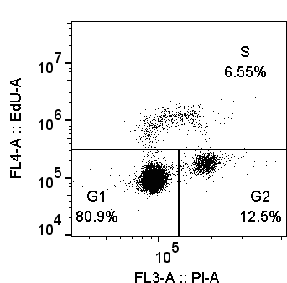
Future plan
Mitotic selection?
Pathway 6 becomes activated when DNA-PK is fully inhibited?
Radiosensitistaion of G1 cells after RT ± SN39536
1 x 10⁶ cells/well (24-well plates)
Day 1
Day 2

Slide 12
 | Plated | G1 (%) ± SE | S (%) ± SE | G2 (%) ± SE | Comments | Cells/mL/cm2 | Confluence in T175 flasks before trypsinisation + plating, passage number
CA-120 (24w Plates) | 10⁵ cells/0.5 mL in 24-well plates (2 x 10⁵ cell/ml) RT at 5 h after plating | 57.4 ± 0.9 | 29.1 ± 0.3 | 10.4 ± 1.7 | 50 uL of 1mM EdU added (final 100 uM) for 1 h before RT. Forgot to add EdU at 18 h Clonogenic assay was done at the same time | 1.05 x 10⁵ | 85% confluent, P21 (~2months in culture) 2.8 m cells seeded 4 days before expt
CA-121 (24w Plates) | 10⁵ cells/0.5 mL in 24-well plates (2 x 10⁵ cell/ml) RT at 5 h after plating | 55.9 ± 0.1 | 28.2 ± 0.1 | 10.9 ± 0.7 | 50 uL of 1mM EdU added (final 100 uM) for 1 h before RT. G2 accumulation 18 h after RT Clonogenic assay was done at the same time (RT only) | 1.05 x 10⁵ | 90% confluent, p23
 | 18 h after RT (85% confluent) (23 h after plating) | 44.8 ± 3.6 | 39.6 ± 1.5 | 13.2 ± 0.6
CA-122 (24w Plates) 1.9cm² per well | 5 x 10⁴ cells/0.5 mL in 24-well plates (10⁵ cells/ml) Cell cycle analysis 24 h after plating | 40.9 | 38.8 | 17 | N=1 (cells from 2 wells were pooled due to insufficient number of cells for FCM analysis, another 2 wells used for clonogenic assay) FCM results on the next slide | 5.26 x 10⁴ | 80-85% confluent
 |  |  |  |  |  | 1.05 x 10⁵
 | 10⁵ cells/0.5 mL in 24-well plates (2 x 10⁵ cells/ml) 24 h after plating | 35 | 25.5 | 12.5
 |  |  |  |  |  | 5.26 x 10⁵
 | 5 x 10⁵ cells/0.5 mL in 24-well plates (10⁶ cells/ml) 24 h after plating | 78.2 | 6.04 | 9.28
 |  |  |  |  |  | 1.05 x 10⁶
 | 10⁶ cells/0.5 mL in 24-well plates (2 x 10⁶ cells/ml) 24 h after plating | 81.4 | 2.36 | 12.3
CC-04 (P60 dishes) 21.29 cm² | 5 x 10⁵cells/5 mL/p60 (10⁵ cells/mL) Irradiated 24 h after plating ~50% confluent at the time of RT | 42.5 ± 1.5 | 47.4 ± 1.3 | 9.6 ± 0.3 | EdU (100uL of 5mM, final conc 100 uM) added 1 h before RT <0.1%DMSO added to cells 1 h before RT | 4.70 x 10³ | 70% p18 5m cells plated 2 days before expt
 | Replicate (zero time after 6 Gy, irradiated 24 h after plating) | 42.7 ± 1.5 | 47.6 ± 1.3 | 9.0 ± 0.1
CC-05 (P60 dishes) 21.29 cm² | 2.5 x 10⁵cells/5ml/p60 (5x10⁴ cells/mL) Irradiated 24 h after plating ~25% confluent | 38.1 ± 0.8 | 37.7 ± 0.7 | 21.1 ± 0.6 | Lowest seeding density, so probably most reliable log-phase estimate Pre-warmed EdU added (5 mL of 100 uM) to cells straight after RT for 30 min | 2.35 x 10³ | 90% p22 (from Way) 2.5 m cells seeded 4 days before expt
 | Replicate (zero time after 6 Gy, 24 h after plating) | 34.0 ± 0.9 | 40.9 ± 0.1 | 22.7 ± 0.5
 | 24 h after RT (48 h after plating, 0 Gy) 50% confluent | 44.8 ± 0.1 | 42.4 ± 0.2 | 11.5 ± 0.1
Cells lost during wash; 2000 single cells collected; not accurate
It takes longer for cells to attach in P60 dishes compared to 24-well plates

Slide 13
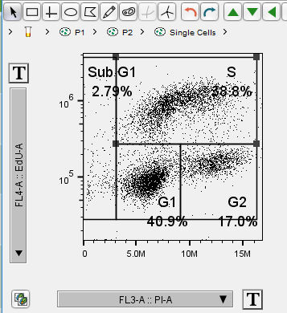
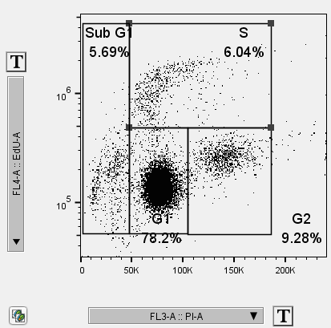
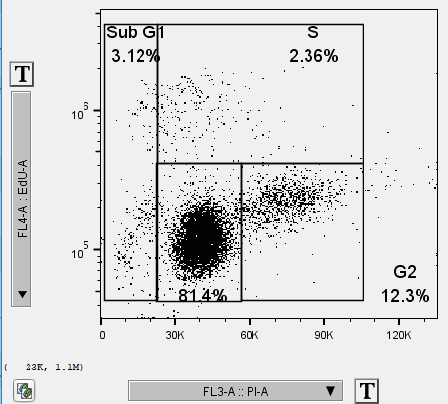
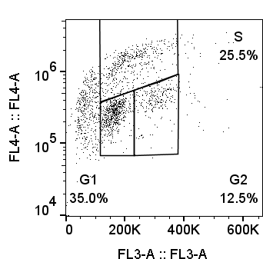
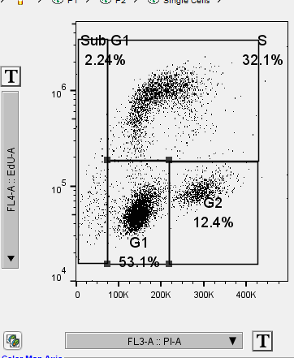
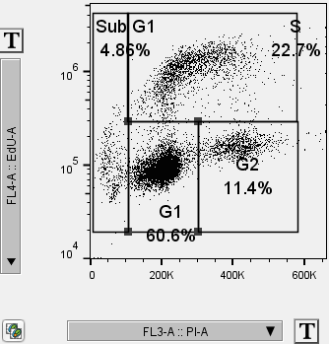
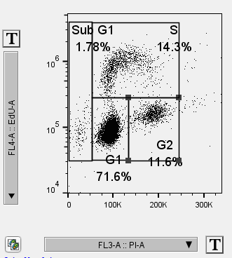
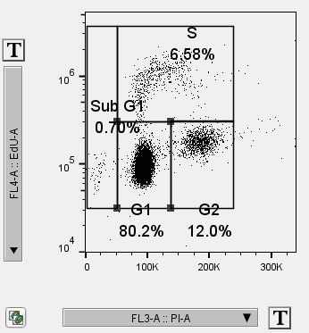
[CA-122] cell cycle data (no rad, 24-well plates)
Median EdU
Days | 5 x 10⁴ cells/well/0.5mL | 1 x 10⁵ cells/w | 5 x 10⁵ cells/w | 1 x 10⁶ cells/w
D-1
D-2
Cells lost during wash

